Slide 1
Hydrogen Risk Mapping and Material Compatibility Modelling in Urban Pipeline Networks
CME 502: Mathematical Analysis and Modeling
Yamini Mann #116394138

Slide 2

Introduction
Hydrogen energy adoption is accelerating globally.
Legacy gas pipeline networks (Steel, Iron, HDPE) were not originally designed for hydrogen exposure.
As hydrogen blending into natural gas infrastructure gains traction, understanding the compatibility of legacy pipeline materials becomes crucial.
Challenges:
Hydrogen can cause accelerated embrittlement, leakage, and catastrophic failure.
Risk mapping and compatibility scoring are essential for safe hydrogen deployment.
Figure 1: Gas Transmission Pipeline network across USA.
Notes:
embrittlement, leakage, and aging

Slide 3
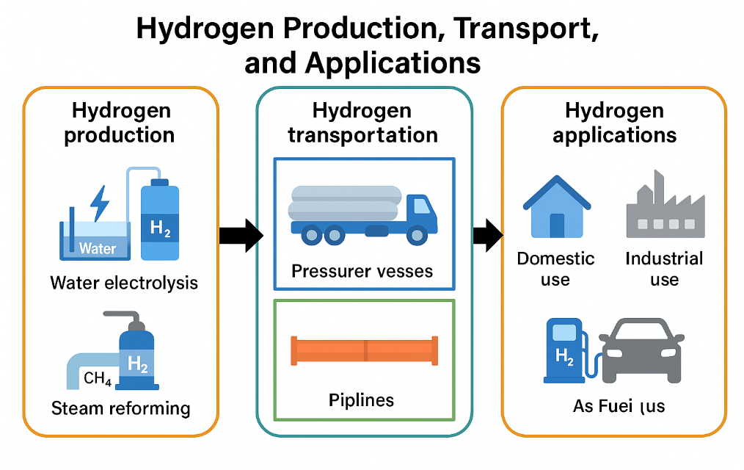
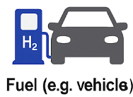
Objective:
Aim:
To numerically model hydrogen risk and evaluate material compatibility in a pipeline network.
Simulate hydrogen diffusion and accumulation in pipelines under service conditions.
Develop a Pipeline Compatibility Index (PCI) scoring model (0 to 1) based on material, stress, and aging parameters indicating how suitable a pipeline segment is for transporting hydrogen safely.
Visualize the spatial distribution of hydrogen risk and material compatibility.
Figure 2: Hydrogen Value Chain
Notes:
Lower PCI → More compatible; Higher PCI → More risky.

Slide 4
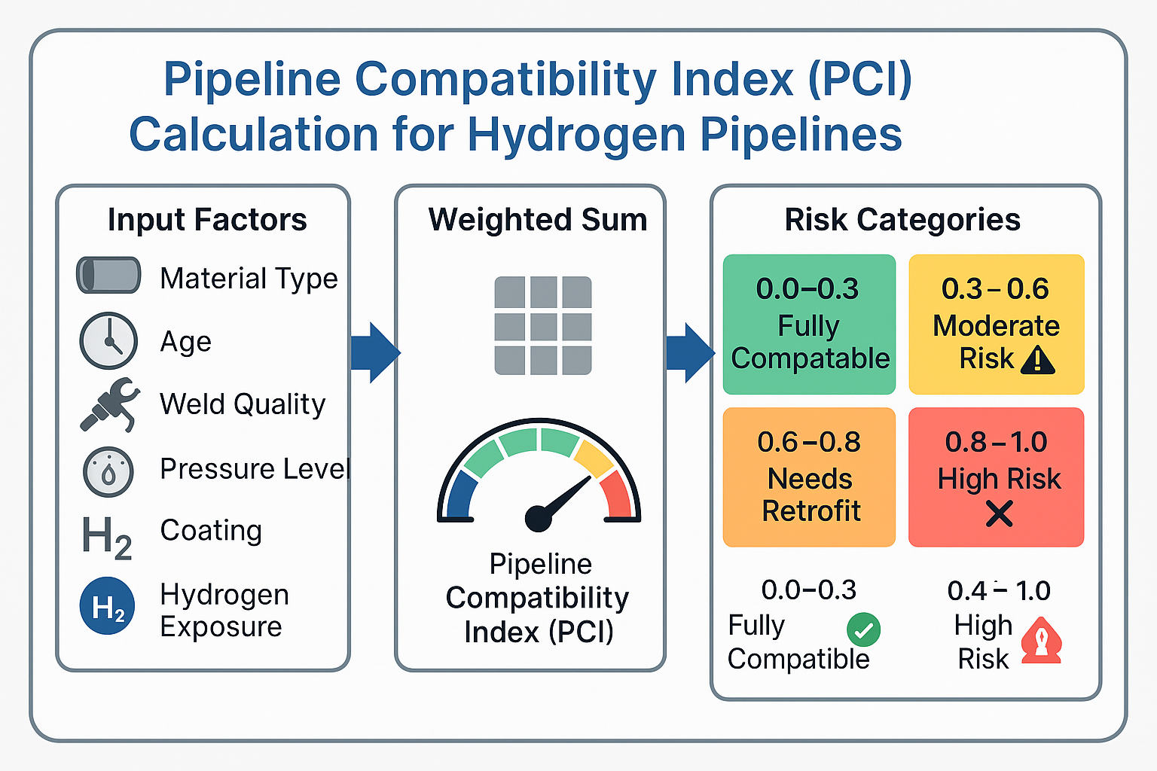
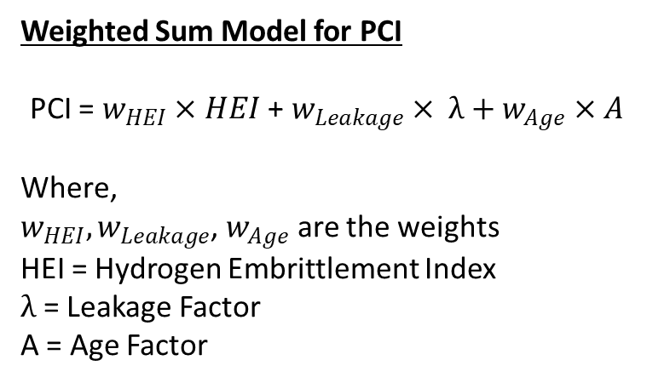
Methodology Overview
Diffusion Analysis
Hydrogen Diffusion Modelling for Steel, Iron and HDPE
Steady-State Flux & Hydrogen Uptake Calculation
Risk Scoring
Material Degradation Analysis
Leakage Rate Estimation
Fracture Toughness Degradation
HEI Calculation
Aging Factor Adjustment
PCI Calculation (HEI + Leakage + Aging Factors)
Risk Categorization (Safe / Moderate / Retrofit / Unsafe)
Weighted Sum Model for PCI
PCI = $w_{HEI}×HEI$ + $w_{Leakage}× λ+w_{Age}×A$
Where,
$w_{HEI}, w_{Leakage}$, $w_{Age}$ are the weights
HEI = Hydrogen Embrittlement Index
$λ$ = Leakage Factor
A = Age Factor
Notes:
Weights are assigned based on importance to failure risk.

Slide 5
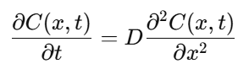
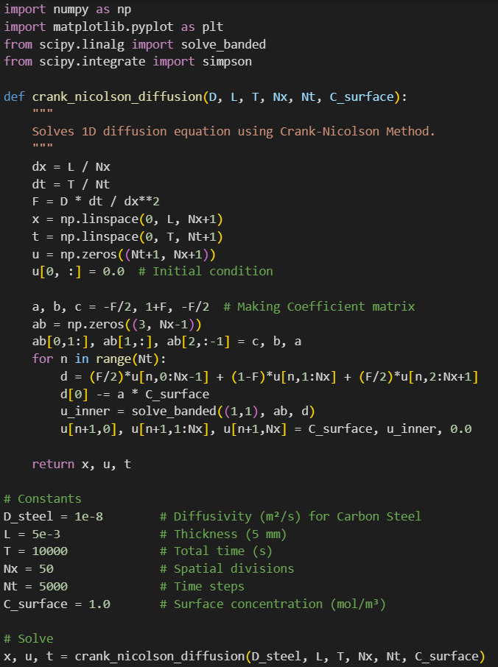
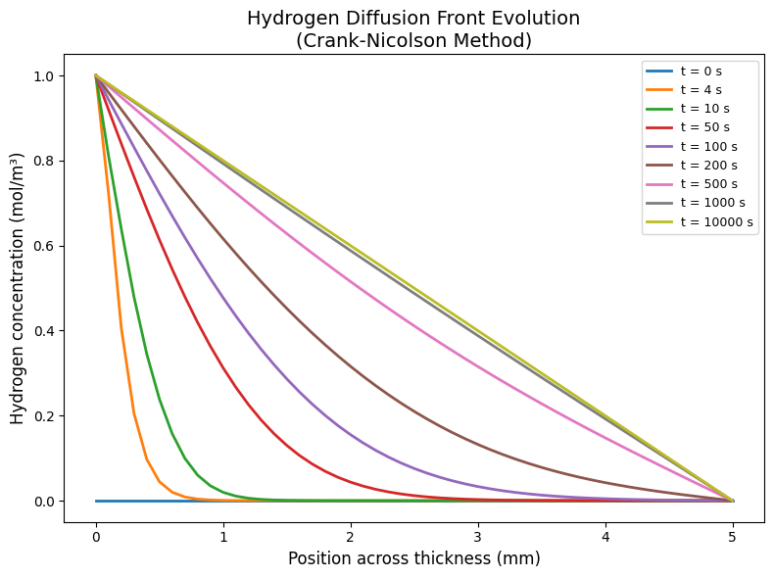
Hydrogen Diffusion Modelling
High Pressure
Low Pressure

Slide 6
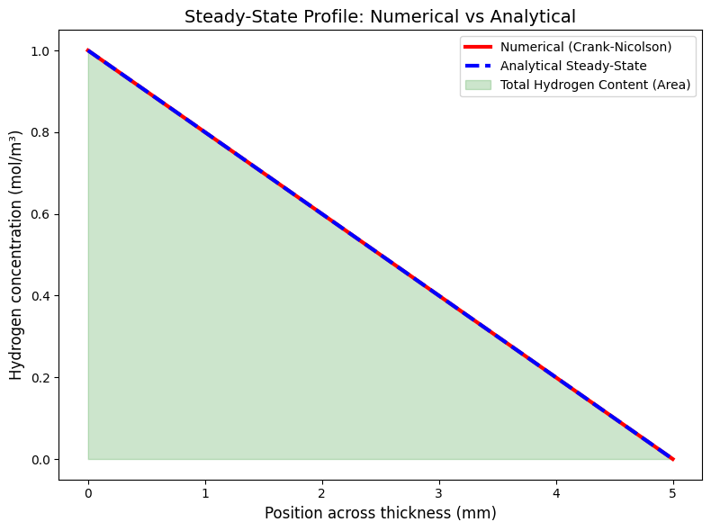
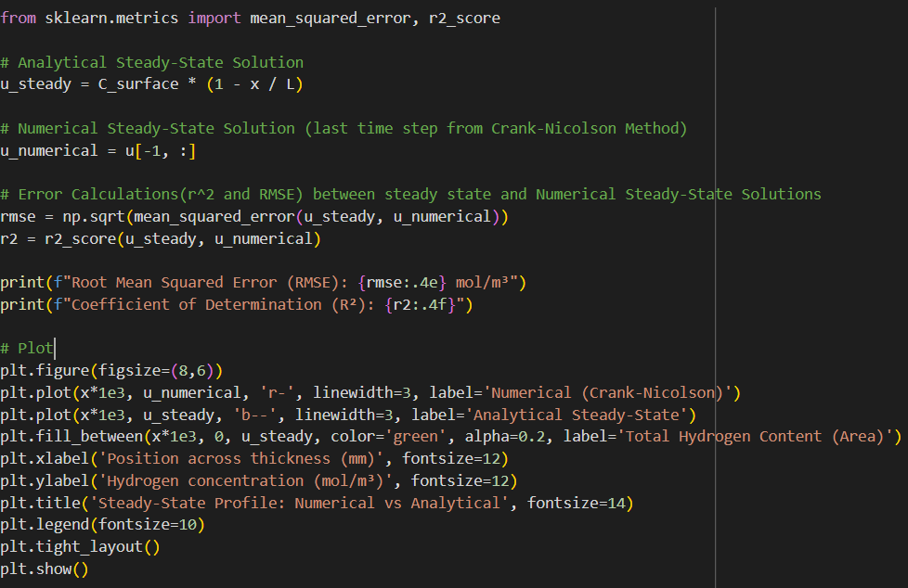
Hydrogen Diffusion Modelling

Slide 7
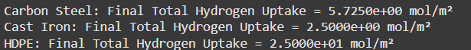
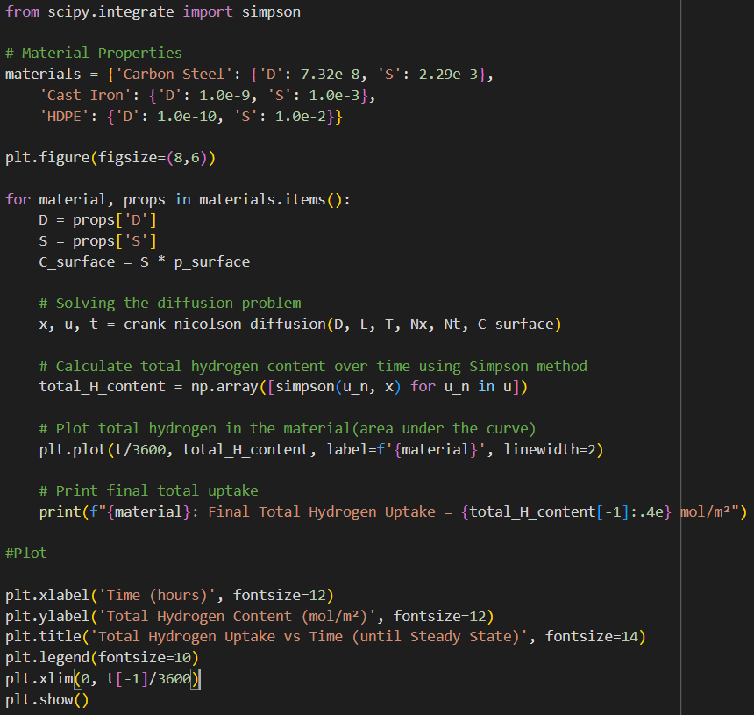
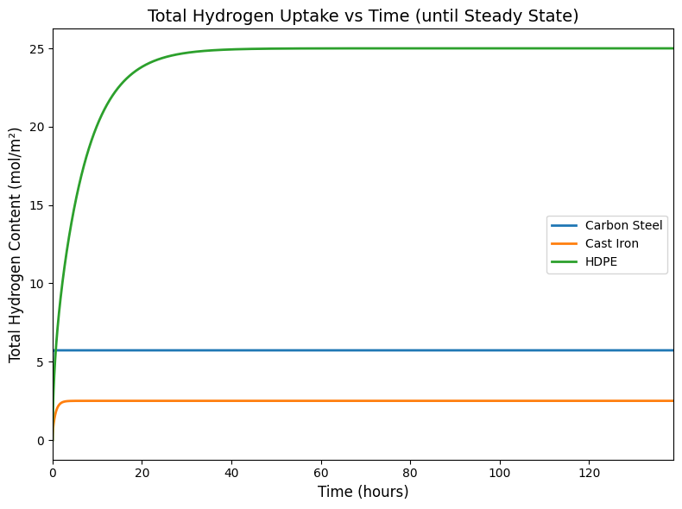
Hydrogen Diffusion Modelling

Slide 8
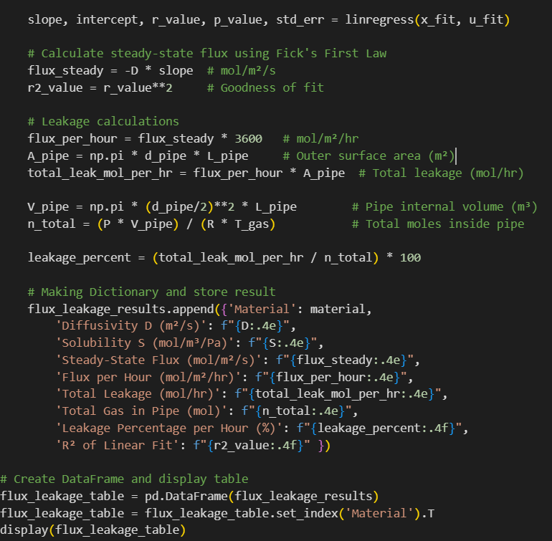
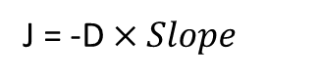
Hydrogen Leakage Estimate
J = -D $×Slope$
Material | Carbon Steel | Cast Iron | HDPE
D (m²/s) | 7.3200e-08 | 1.0000e-09 | 1.0000e-10
S (mol/m³/Pa) | 2.2900e-03 | 1.0000e-03 | 1.0000e-02
Steady-State Flux (mol/m²/s) | 3.3526e-02 | 2.0000e-04 | 2.0000e-04
Flux per Hour (mol/m²/hr) | 1.2069e+02 | 7.2000e-01 | 7.2000e-01
Total Leakage (mol/hr) | 1.1375e+02 | 6.7858e+01 | 6.7858e+01
Total Gas in Pipe (mol) | 2.8887e+03 | 2.8887e+03 | 2.8887e+03
Leakage Percentage per Hour (%) | 3.7796 | 2.3491 | 2.3491
R² of Linear Fit | 1.0000 | 1.0000 | 1.0000

Slide 9
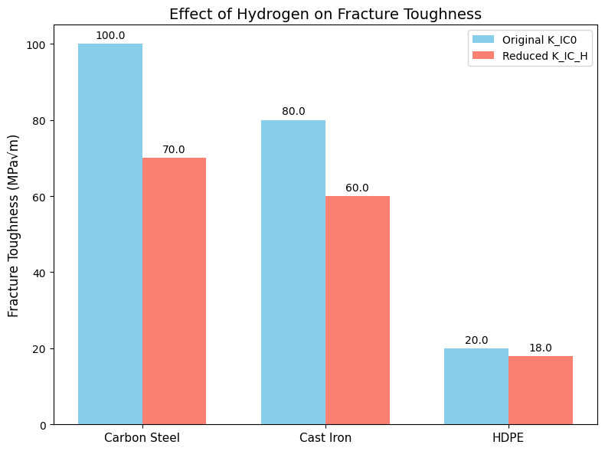
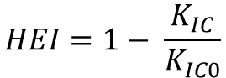
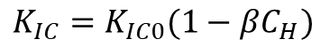
Fracture toughness degradation and
Hydrogen Embrittlement Index (HEI)
They interaction of Hydrogen with microstructural defects.
This leads to weakening of atomic bonds and causes reduction in fracture toughness.
$$HEI=1− \frac{K_{IC}}{K_{IC0}}$$
$$K_{IC}=K_{IC0}(1−βC_{H})$$
 | Original K_IC0 (MPa√m) | Reduced K_IC_H (MPa√m) | β (m³/mol) | HEI (%)
Carbon Steel | 100 | 70 | 6.00e-05 | 30.00
Cast Iron | 80 | 60 | 5.00e-05 | 25.00
HDPE | 20 | 18 | 2.00e-05 | 10.00
Notes:
Quantify H degradation due to H2 exposure

Slide 10
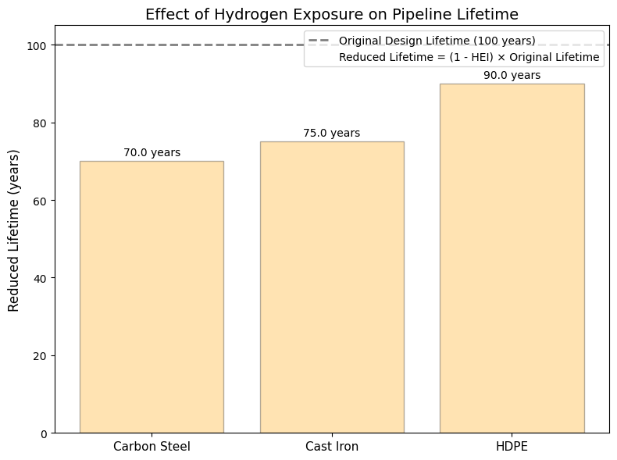
Material Lifetime Estimation
Reduced Lifetime = (1 - HEI) × Original Lifetime
 | HEI | Original Lifetime (years) | Reduced Lifetime (years)
Carbon Steel | 0.30 | 100 | 70.00
Cast Iron | 0.25 | 100 | 75.00
HDPE | 0.10 | 100 | 90.00

Slide 11
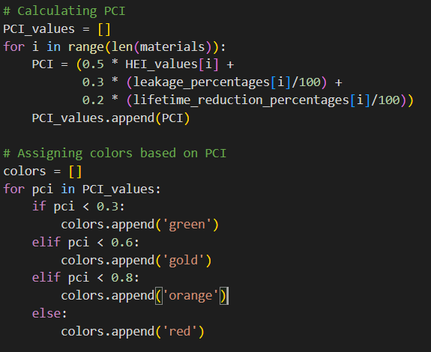
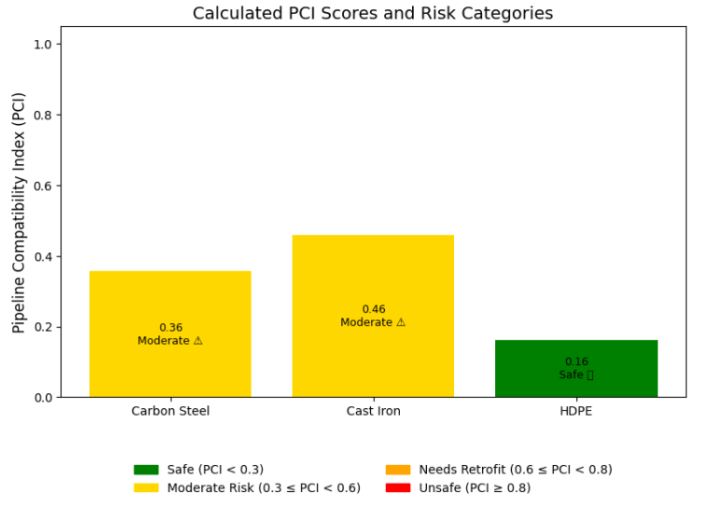
Pipeline Compatibility Index (PCI) PCI Visualization
PCI = 0.5 × HEI + 0.3 × Leakage % + 0.2 × Lifetime Reduction %

Slide 12
References
Borgschulte, A., et al. (2015). Hydrogen diffusion in metal hydrides. Journal of Alloys and Compounds, 645, S521–S525. https://doi.org/10.1016/j.jallcom.2015.03.235
Anderson, T. L. (2017). Fracture Mechanics: Fundamentals and Applications (4th ed.). CRC Press.
Yang, F., & Liu, H. (2014). Hydrogen diffusion coefficient in liquid metals evaluated by molecular dynamics. Transactions of Nonferrous Metals Society of China, 24(9), 2870–2875. https://doi.org/10.1016/S1003-6326(14)63565-2
Oriani, R. A. (1970). The diffusion and trapping of hydrogen in steel. Acta Metallurgica, 18(1), 147–157. https://doi.org/10.1016/0001-6160(70)90078-7
Ding, Y., Xu, P., Lu, Y., Yang, M., Zhang, J., & Liu, K. (2023). Research on Pipeline Leakage Calculation and Correction Method Based on Numerical Calculation Method. Energies, 16(21), 7255. https://doi.org/10.3390/en16217255
Zhang, R., Ai, S., Long, M., Wan, L., Li, Y., Jia, D., Duan, H., & Chen, D. (2024). Quantitative Study on Hydrogen Concentration–Hydrogen Embrittlement Sensitivity of X80 Pipeline Steel Based on Hydrogen Permeation Kinetics. Metals, 14(7), 763. https://doi.org/10.3390/met14070763

Slide 13
Thank You!

